Slide 1
PATIENT HEALTH RECORD MANAGEMENT SYSTEM USING BLOCKCHAIN
ARAVIND KRISHNA A V
ROLL NO:20
S3 MCA

Slide 2
ABSTRACT
The need for maintaining an accurate and infallible record of an individual’s medical records
and bills can’t be understated. Reproducing these documents is essential to ensure that the
insurance claim process goes about smoothly and without hinderance. Conventional methods
of record keeping often prove to be inefficient and vulnerable to data leakage.This Blockchain-
based Patient Data Management System has been designed to eliminate any scope of fraud
or manipulation that could take place with respect to the processing of medical bills and the
insurance claim. This system consists of the three entities: Hospital Department, Medical
Department, & Insurance Company. The Hospital Department needs to first add the patient
and create their id. Once the patient id is created, the medical department of the hospital can
start adding the bills. The insurance company can search for patients using their id and
recover all the bills uploaded by the medical department. After the bills have been recovered
from the hospital’s side, the insurance company can cross check them against the bills
submitted by the patient. In this proposed work, the Data of patient mostly the finance
related data is being added here. It’s difficult to understand or keep a track of the bills for any
user. Since there are a lot of scams going with respect to hospital and insurance companies
when the final settlement is done. Blockchain technology kills scope of manipulation and
tampering of the data, here the insurance company has access to the bills added by the
company plus it can added the bills which the patient has to cross verify if there has been any
kind of manipulation by the hospital end.

Slide 3
LITERATURE REVIEW
Towards using Blockchain technology for eHealth data access management
Decentralized e-Health Architecture for boosting health-care Analytics
Introducing Blockchain for Healthcare

Slide 4
MOTIVATION
The traditional method which is followed in most of the
hospitals for maintaining records is the manual method which
includes papers and books. This method has serious lim-
itations such as a need for large storage areas and retrieval
of records is difﬁcult. In the present era computerization of
clinical records has become popular as the storage and retrieval
of the records is easy.
However, the chances of manipulation without identiﬁcation has become a serious concern.
Another major perturb is the maintenance of patient records conﬁ-
dentially as the patient can hold the doctor and the hospital
irresponsible for breaking the conﬁdentiality of his medical
Records.Also, paper-based records are often incomplete, giving rise
to unwanted repeat testing and medication. There is wastage
of time since this system needs more manual power for
transferring records by mail or faxes as these are dispersed
and are not centralized. Even accessing of medical records
by doctors is limited.

Slide 5
EXISTING SYSTEM
Presently healthcare organizations use a centralized method
for saving patient’s information, diagnostic reports, and doc-
tor’s prescription. Since it is a centralized system there are
chances of data getting leaked or exploited for various reasons
as patients don’t have control over their data and also ex-
changing of the recorded data is time-consuming & a complex process.Health-
care organizations generate sensitive and critical medical data
at every stage of medical treatment like a consultation,diagnosis, and surgery. The medical data comprises of doctor’s prescriptions, X-rays, MRI scans, ultrasound reports,
angiography, radiography, endoscopy and also few sensitive
health information like HIV diagnosis, cancer diagnosis or
psychological conditions.

Slide 6
PROPOSED SYSTEM
With the aim of dealing with these problems, this work uses the idea of switching a centralized system to a decentralized system using Blockchain technology.On the Blockchain network, patient’s health records can be saved using their public keys and transactions containing patient’s health records are saved with their unique IDs and patient’s public key. Healthcare organizations can access the patient’s non-identiﬁable data through smart contracts only when the unique IDs match. If required patients can share the public key with the health organizations but without the private key data would always remain non-identiﬁable

Slide 7
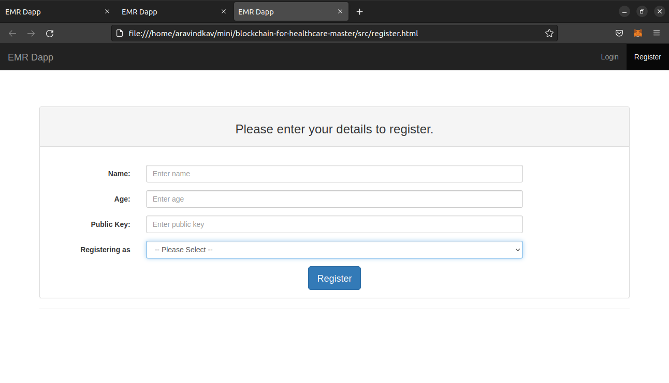
DEMO

